Slide 1

Predicting Ad Clickthrough-Rate (CTR)
on real and synthesized ads data
STATS 414: Generative AI
Setara Nusratty,
Nils Berzins,
Rohan Narasayya,
Lucy Lennemann
December 2025

Slide 2
(1) Problem Overview
December 2025
What is the best approach to generate synthetic data to improve CTR classification?
Notes:
Specifically - comparison of large language models vs. deep learning methods to generate synthetic data and develop a pipeline to do so

Slide 3
(2) Data Pruning
December 2025
Goal: Reduce computational requirements by narrowing the scope of the problem
Original ads dataset: 7 million rows, 35 predictors
Narrow down to top six task_ids, D1 to D6
Focus on users who have at least clicked on an ad once
Notes:
Because of computational constraints, we did a subgrouping by extracting six task_id subgroups with highest occurrence frequency, and then we extracted the users (user_id) who had ever had a positive label

Slide 4
(2) Data Processing
December 2025
Converting variables to correct data type
  pt_d → datetime
Downcasted numerical data types, reducing memory footprint
Engineer new count of interest category features
Remove ID_fields for synthetic data generation
Remove uninformative features through XGBoost importance analysis
Notes:
Uninformative features - based on what Thomas did

Slide 5
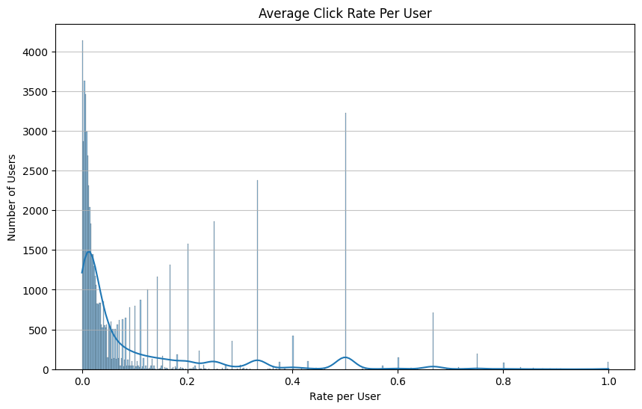
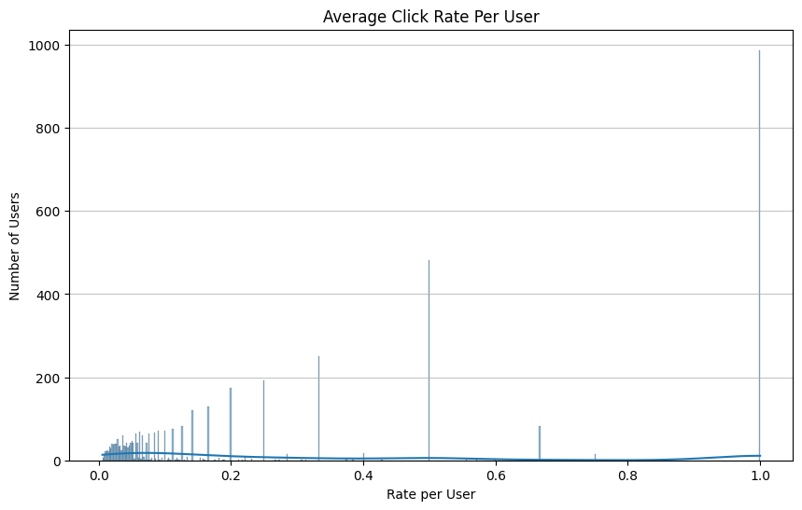
(3) Data Analysis Pre/Post Pruning
December 2025

Slide 6
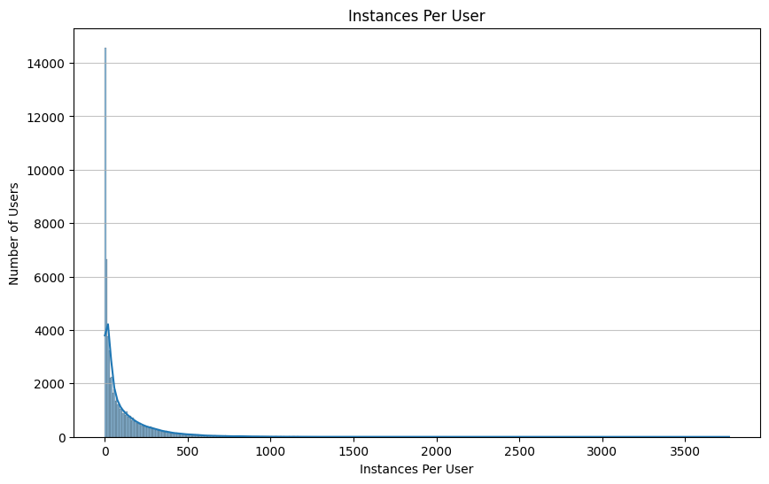
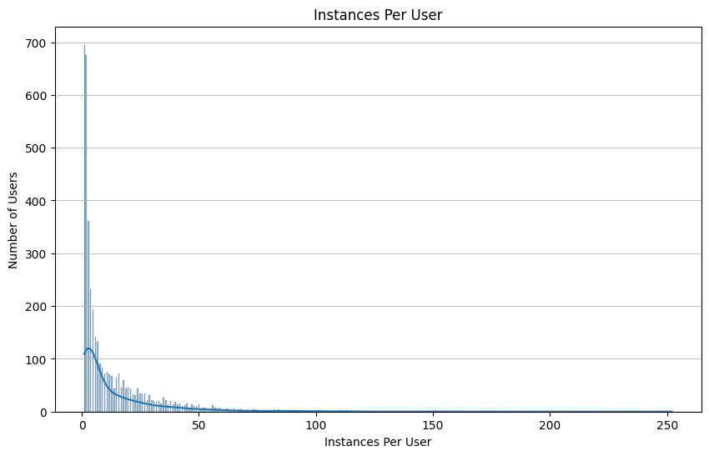
(3) Data Analysis Pre/Post Pruning
December 2025

Slide 7
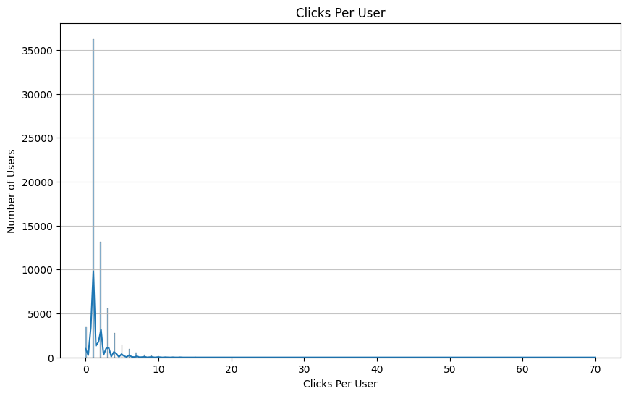

(3) Data Analysis Pre/Post Pruning
December 2025

Slide 8
(3.1) Data Analysis Post Pruning
December 2025
Dataset | task_id | rows_before | rows_after | ctr_before | ctr_after
1 | 22100 | 154812 | 4628 | 0.001815 | 0.060717
2 | 14584 | 126367 | 29359 | 0.014790 | 0.063660
3 | 34382 | 122094 | 2724 | 0.001589 | 0.071219
4 | 34975 | 92381 | 3880 | 0.001927 | 0.045876
5 | 31941 | 77470 | 12677 | 0.032167 | 0.196576
6 | 31996 | 69691 | 1555 | 0.002525 | 0.113183
Full Dataset CTR: 0.0947 (9.47%)

Slide 9
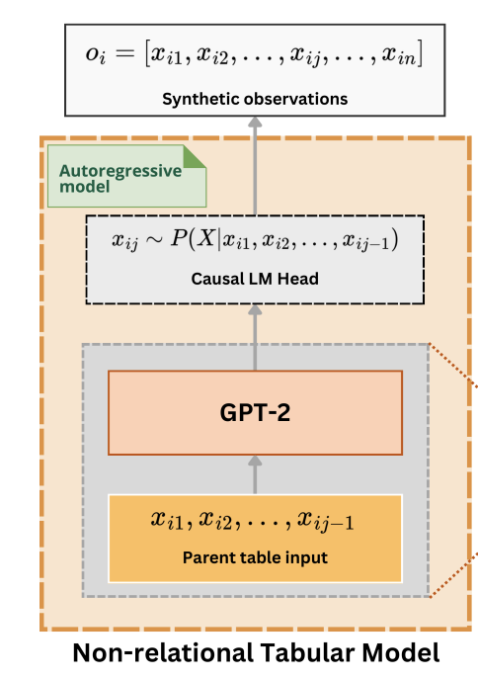
(4) Synthetic Data Generation: Realtabformer
December 2025
Realistic Relational and Tabular Transformer
Uses autoregressive transformer model, ChatGPT-2
Changed hyperparameters to shorten training process
  75 epochs, turned off full sensitivity
Train a different model for each subset of data D1 - D6 and generate a sample of 10,000 rows
Notes:
LUCY -
2 different models to generate synthetic data
Realtabformer: can do relational and non-relational data
Autoregressive transformer model learns the conditional distribution, assuming that there are dependencies in a given row of data.
In generation, sequentially generates tokens for each row
Shortened training, which may have hampered the quality of the generated data. Need further time to continue with hyperparameter tuning
Full sensitivity: This sensitivity metric is used to assess whether synthetic data systematically copies observations from the training data, which could indicate overfitting or privacy risks.

Slide 10
(4) Synthetic Data Generation: CTGAN
December 2025
Conditional generative adversarial network
Uses 2 neural networks, the generator and the critic, to improve the synthetic data
Learns distributions more accurately due to techniques like conditional generation and oversampling of rare categories
Train a different model for each subset of data D1 - D6 and generate a sample of 10,000 rows
Notes:
LUCY - more classical approach
LLM vs. more classical approach
Explain GAN
Techniques to learn distributions
Was able to train more epochs due to less time

Slide 11
(5) Problem Overview
December 2025
How can we develop a framework to evaluate generated synthetic tabular data?
Notes:
LUCY given these 2 datasets, Skeleton - fidelity, utility, privacy

Slide 12
(6) Evaluation: Data Privacy
December 2025
Realtabformer already implements regularization to prevent data-copying
  Uses target masking: artificially introducing missing values
  Computes a stopping threshold to avoid overfitting using distance to closest record
Further statistical tests to be evaluate data post-generation
  DCR using Realtabformer method
  Membership inference attacks (more comprehensive)
Notes:
LUCY - as a baseline, target masking randomly masks some tokens in a row. Learn with masks, but then force model during generation to fill in the masked values probabilistically
DCR: for each record in the synthetic dataset, what’s the distance to the closest real data record? Don’t want the average DCR to be too low, so realtabformer has early stop
Membership inference attacks: classifier to determine if a record was in the real dataset for creating synthetic data
Attribute disclosure risk refers to the possibility that an intruder can determine new or additional information about an individual's attributes from released data, even without directly identifying the individual

Slide 13
(6) Evaluation: Fidelity
December 2025
Conditional generative adversarial network
Uses 2 neural networks, the generator and the critic, to improve the synthetic data
Learns distributions more accurately due to techniques like conditional generation and oversampling of rare categories
Train a different model for each subset of data D1 - D6 and generate a sample of 10,000 rows

Slide 14
(6) Slide noting high-level synth data evaluation
December 2025
Fidelity Evaluation:
  Marginal dists can be estimated w/ total variational distance, correlations, and Cramer’s V
  Univariate Measures
    mean, sd, skewness, etc
    Chi-squared / total variation distance between empirical distributions
  Pairwise
    Numeric-Numeric -> matrix distances on between corr matrices
    Categorical-Categorical -> Cramer’s V
  Classifier Modeling e.g. RandomForestClassifier modeling whether synthetic or not
    If close to random guessing, P and Q are similar
  PRD Precision-Recall on CTGAN and RTF separately
    Drop to lower dimension space (PCA)
  How close is the data to the real data?

Slide 15
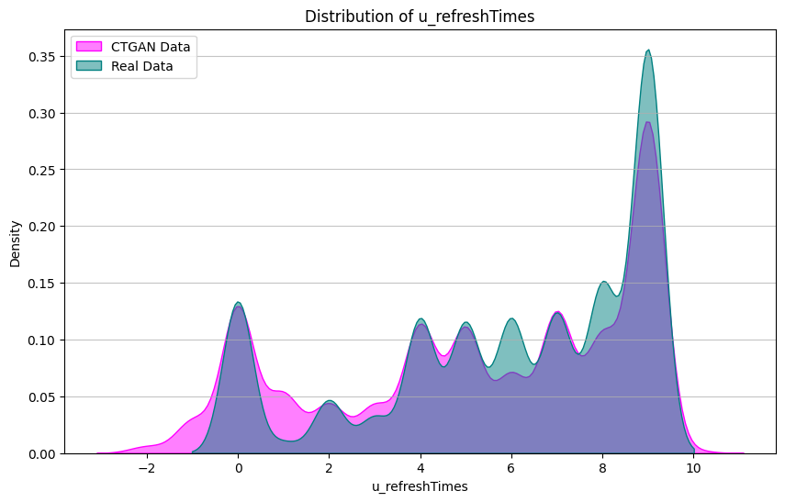
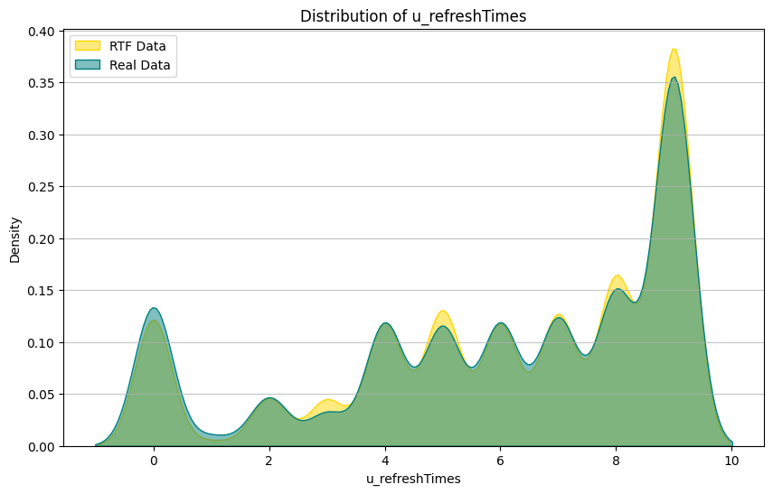
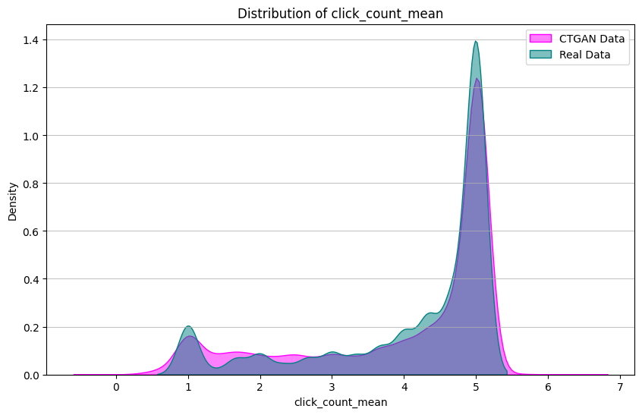
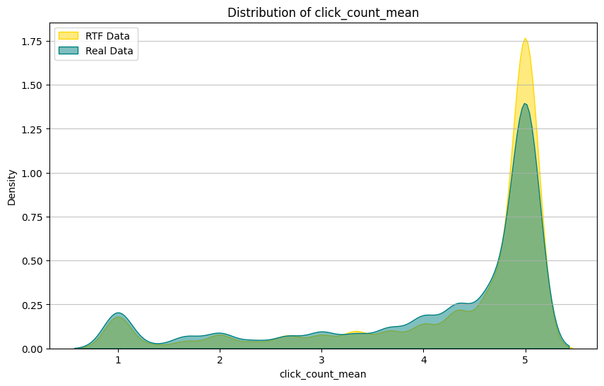
(6) Fidelity: Graphical Analysis
December 2025
Notes:
Here, I’m comparing the distributional fidelity of two key features from our advertisement click-through dataset: u_refreshTimes and click_count_mean.
On the left, you see the CTGAN synthetic data overlaid on the real distribution, and on the right, you see the same comparison for ReaLTabFormer.
Both models do a reasonably good job of capturing the overall shape and regional density of the original data. But visually, ReaLTabFormer shows a tighter overlap with the real distributions — especially around the major modes. That suggests it’s capturing not just the broad structure, but also the fine-grained density patterns more accurately.
So at least from a graphical fidelity standpoint, ReaLTabFormer appears to produce higher-quality synthetic samples than CTGAN.

Slide 16
(6) Fidelity: Total Variational Distance and Marginal Cramer’s V
Numerical Features: Total Variational Distance
Categorical Features: Cramer’s V
Feature | TVD_CTGAN | TVD_RTF
u_refreshTimes | 0.101774 | 0.032038
u_feedLifeCycle | 0.098143 | 0.014617
u_newsCatIntesrestST_count | 0.093361 | 0.014055
click_count_mean | 0.377356 | 0.087038
close_count_mean | 0.037952 | 0.008097
Feature | CramersV CTGAN | CramersV RTF
age | 0.101708 | 0.094325
gender | 0.026075 | 0.034176
city_rank | 0.083767 | 0.086042
device_size | 0.350771 | 0.368568
slot_id | 0.464447 | 0.448289
Notes:
“On this slide, I’m comparing fidelity across both numerical and categorical features using two quantitative metrics: Total Variational Distance for numeric fidelity, and Cramer’s V for categorical fidelity.
Starting with the numerical features on the left:
TVD measures how different two distributions are, where zero indicates perfect overlap. In practical terms, values below about 0.1 reflect a very strong match, and anything above 0.3 suggests a meaningful deviation from the real data.
Across all five numerical features, ReaLTabFormer consistently achieves much lower TVD values than CTGAN. For example, u_refreshTimes drops from roughly 0.10 in CTGAN to about 0.03 in RTF, and several features—like u_feedLifeCycle and close_count_mean—fall well below 0.02. Even for the feature with the largest deviation, click_count_mean, RTF cuts the distance by more than half. This tells us that RTF recreates the real numeric distributions much more faithfully.
Moving to the categorical features on the right, we use Cramer’s V, which measures the strength of association between categorical variables. Values close to zero indicate weak or no association—which is normal for many features in this dataset—and higher values indicate stronger relationships. What matters here is whether the synthetic Cramer’s V resembles the real-data association strength, not whether it is large in absolute terms.
First, looking at marginal distributions—meaning each categorical feature individually—RTF generally produces Cramer’s V values closer to the real feature distributions. This indicates RTF better replicates the standalone behavior of features like age, gender, city rank, and device size.
Next, when we examine pairwise relationships, the story is similar. By comparing the full Cramer’s V matrices for the real data, CTGAN, and RTF, we see that RTF more accurately preserves the inter-feature relationships, especially for features with moderate association strengths like device_size and slot_id. CTGAN tends to deviate more from the real relationship structure, meaning its synthetic feature interactions are less aligned with the true dataset.
In summary, ReaLTabFormer shows superior fidelity across both numerical and categorical dimensions. It more closely matches the real feature distributions via lower TVDs, and it better preserves both the individual and pairwise categorical associations reflected by Cramer’s V.”

Slide 17
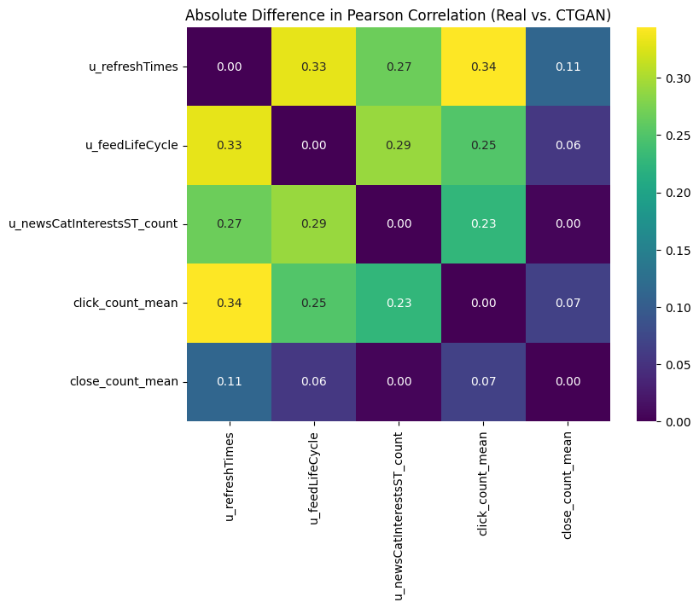
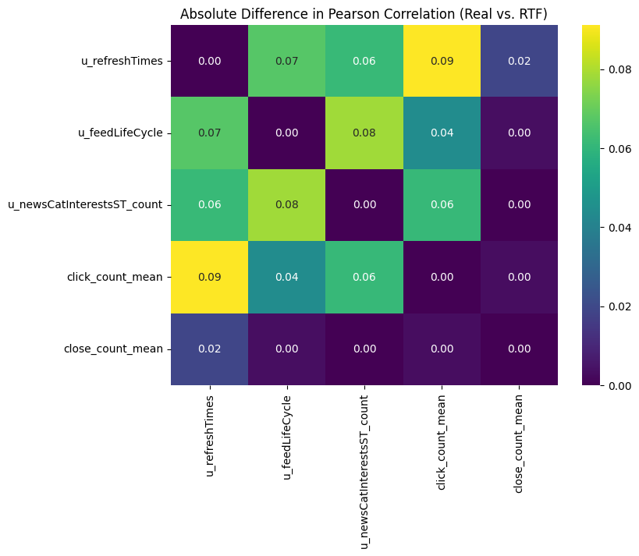
(6) Fidelity: Absolute Correlation Differences
December 2025
Notes:
Lower values indicate that the synthetic data maintains the same linear relationships between features that exist in the real data. Higher values—especially those above about 0.20 or 0.25—suggest that the model is distorting or failing to capture those relationships.
Looking first at CTGAN on the left, we see several feature pairs with relatively large correlation differences, often in the 0.25 to 0.35 range. That means CTGAN is not consistently preserving how these features move together in the real dataset. For instance, correlations involving u_refreshTimes and click_count_mean show some of the largest deviations, indicating notable structural shifts.
In contrast, on the right, ReaLTabFormer shows substantially smaller differences across the board. Most correlation gaps fall below 0.10, and many are essentially zero. This tells us that RTF is faithfully reproducing the underlying dependency structure between features—capturing not only the individual distributions but also how these numerical features co-vary.

Slide 18
(6) Fidelity: Random Forest Classifier
December 2025
Detection of Synthetic Data Classification Report
Label | Precision | Recall | F1-Score | Support
0 | 0.78 | 0.72 | 0.75 | 16447
1 | 0.88 | 0.91 | 0.89 | 36000
Accuracy Score: 0.85067
Notes:
With a blended dataset that included original, CTGAN, and Realtabformer Data where there was roughly a ⅓ split of each within the dataset.
The model achieved an overall accuracy of about 85%, which tells us that the synthetic observations are still distinguishable from real ones with fairly high confidence. Looking more closely, Label 1—synthetic data—has a notably high recall of 0.91 and an F1-score of 0.89, meaning the classifier is very good at correctly identifying synthetic samples. Label 0—real data—shows lower recall at 0.72, suggesting it is making more mistakes when trying to classify real rows as real, not that surprising considering that only ⅓ of this specific data blend was not synthetic.
Overall, this result indicates that while both CTGAN and ReaLTabFormer generate data with strong marginal and relational fidelity, there remain detectable patterns that separate synthetic records from real ones. This doesn’t invalidate the utility of the synthetic data, but it highlights that neither model reaches full indistinguishability—and that ReaLTabFormer, despite being higher fidelity, may still produce subtle artifacts that a classifier can learn to pick up.”

Slide 19
Slide noting high-level synth data evaluation
December 2025
Utility Evaluation:
  Choosing downstream task (already doing, predicting classification 1/0)
    Test different levels of synthetic data inclusion
    ALSO, train on synthetic, test on real
  Model Selection → Taking many models and seeing how introduction of synth data changes optimal model
    Rank by performance
    If performance is consistent across different synth data injection levels, can actually use synth data for true predictive modeling
  Utility-interpretability trade off
  How useful is the data for a task?

Slide 20
(7) Utility: Modeling Pipeline Overview
December 2025
Goal: Compare utility of CTGAN vs RealTabFormer synthetic data
Two identical pipelines: Same preprocessing, models, ratios
Data: 54k real (60% train, 20% val, 20% test) + 60k synthetic (D1-D6 per generator)
Models: L1 Logistic Regression and XGBoost
Experiments: Real-only, Synthetic-only, Mixed (0.10×–1.64×)
Evaluation: AUC and PR-AUC (test set)
Notes:
The goal of the modeling pipeline is to evaluate how useful the synthetic data is for improving click-prediction performance. For both generators we use the same preprocessing, models, and mixing ratios for accurate comparison.
We start with the 54,000 row pruned dataset split into 60% train, 20% validation and 20% test, and 60,000 synthetic samples per generator.
We run two classifiers: an L1-regularized Logistic Regression, and XGBoost.
For each model, we test three conditions: a real-only baseline, a synthetic-only baseline, and mixed datasets where we add synthetic data to the full training data at ratios from 0.10× up to 1.64× the real training size.
Each ratio tells us how much synthetic data we add relative to the real training data.
For example, a ratio of 0.10× means we add synthetic data equal to 10% of the real training set
Finally, we use AUC and PR-AUC on the test set as our primary metrics for evaluation.

Slide 21
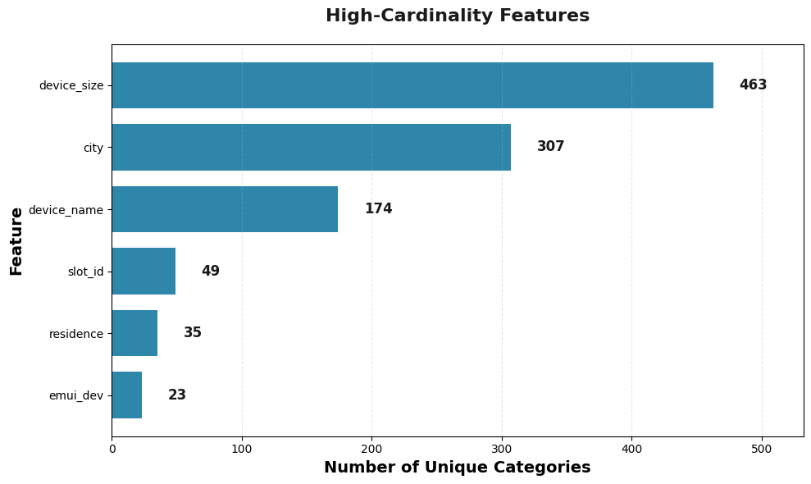
(7) Logistic Regression Preprocessing
December 2025
Numerical features → StandardScaler
Low-cardinality features → One-Hot Encoding
High-cardinality features → Target Encoding:
  Minimum 20 unique values per feature
  Smoothing (Pulls value toward global mean)
  Clipping to ±3σ (Prevents any encoded value from going outside a realistic range )
Notes:
For logistic regression preprocessing, we use StandardScaler for numerical features. This standardizes each variable to have mean zero and unit variance.
For low-cardinality categorical features we use regular one-hot encoding.
For high-cardinality categorical features, one-hot encoding would lead to coefficient explosion. Instead, we use a robust target encoder.
Target encoding replaces each category with a single number: the smoothed average click-through rate for that category. To prevent overfitting, we add three stabilizing mechanisms.
First we require at least 20 unique value before we apply target encoding.
The second is smoothing: categories with a smaller number of values get pulled toward the global mean Click through rate, so that rarer categories don’t produce noisy estimates.
And third, we clip values to plus or minus three standard deviations from the global mean to keep everything in a realistic probability range.

Slide 22
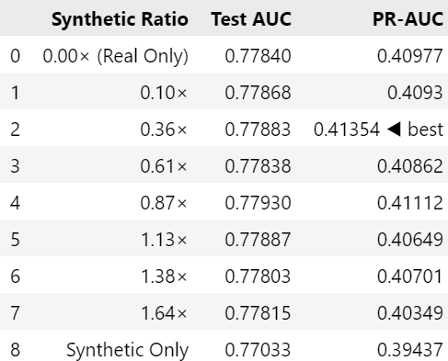
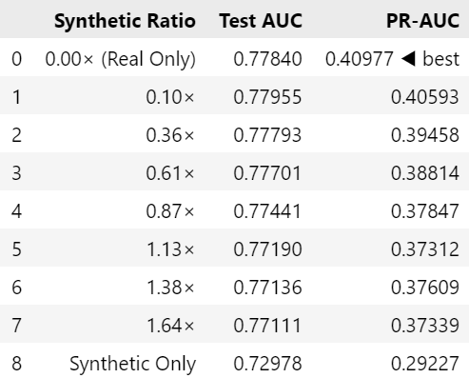
(7) Logistic Regression Results
December 2025
Realtabformer
CTGAN
Notes:
For the results of logistic regression, looking at RealTabFormer, the best result comes at the 0.36 ratio, but it’s only a very small lift over real-only baseline.
Now on the CTGAN side, the story is different. The real-only model is actually the best performer and as we add CTGAN synthetic data, performance consistently declines. Furthermore, the synthetic-only CTGAN model performs the worst overall by a wide margin.

Slide 23
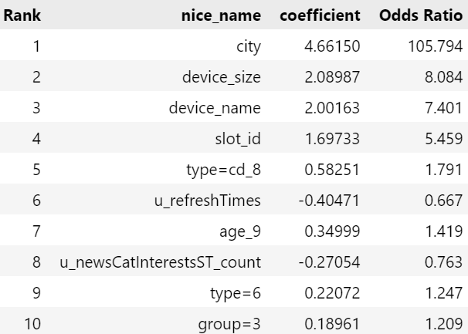
(7) Logistic Regression Interpretation
December 2025
City dominates model signal
Device type & size matter
Slot ID strongly predictive
Other features have small effects
Notes:
Looking at the coefficients for the optimal logistic regression model, the biggest effect by far is city, So where a user lives is the single strongest driver of click behavior.
Next are device_size and device_name, meaning device characteristics strongly influence how likely someone is to click.
Slot ID is also very predictive, which makes sense because different ad placements have very different baseline click through rates.
After that, we see the rest of the top features provide smaller but still meaningful effects.

Slide 24
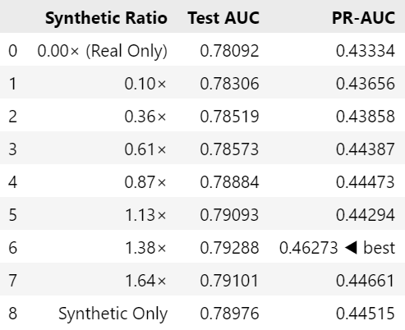
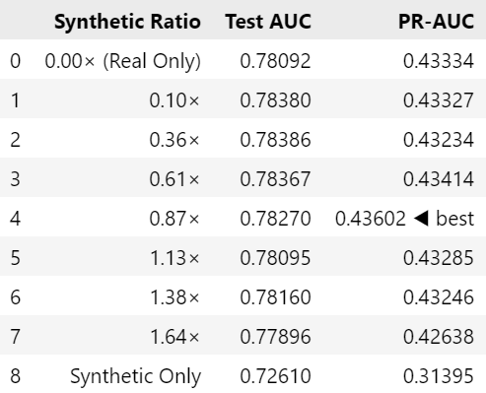
(7) XGBoost Results
December 2025
Realtabformer
CTGAN
Notes:
Now moving to the results of XGBoost, we see it performs better across the board compared to logistic regression. Both generators clearly help the model, but RealTabFormer provides a much stronger lift.
For RealTabFormer, performance improves as we increase the synthetic ratio with an optimal precision at 1.38×.
For CTGAN, It achieves its best precision around the 0.87× ratio, and then gradually declines. Once again, the synthetic-only performance drops off much more sharply than RealTabFormer.

Slide 25
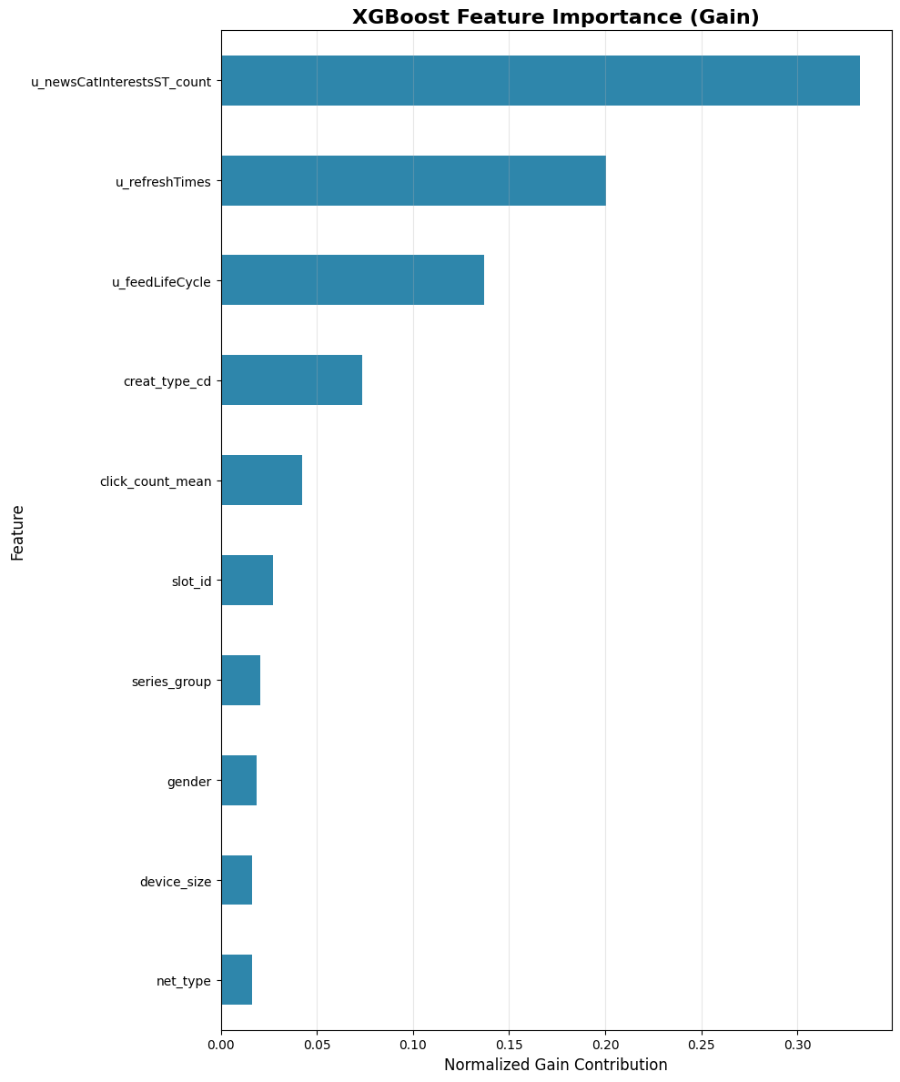
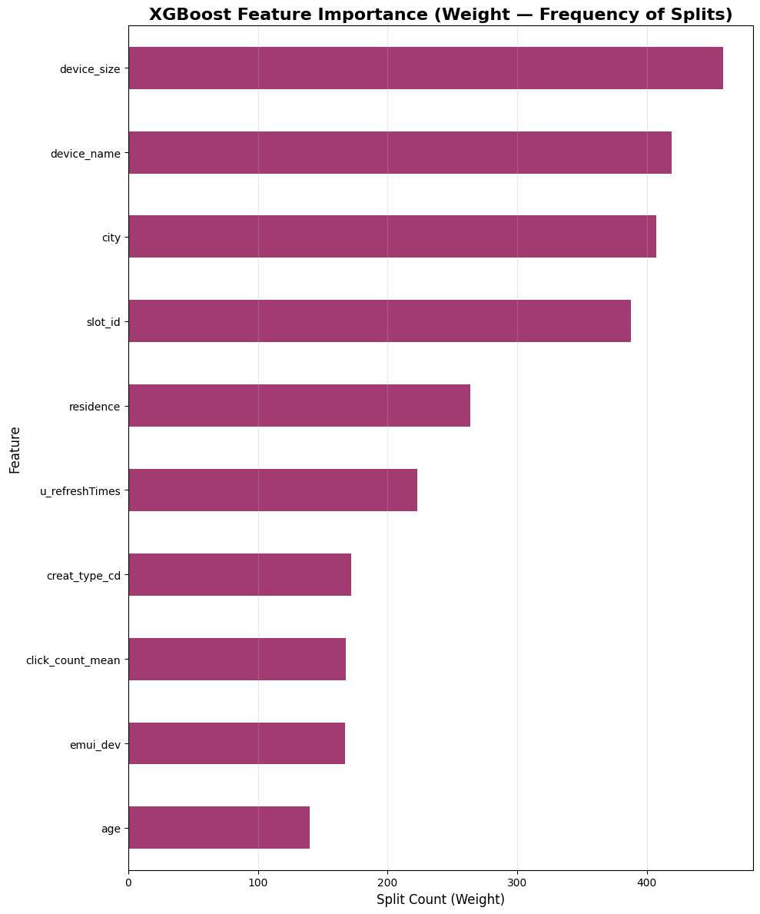
(7) XGBoost Feature Importance
December 2025
Notes:
Looking at the feature importance plots, on the left, we have Gain importance.
This measures how much each feature improves the model’s splitting decisions.
Here, the top predictors are all engagement related:
News category interest count, Refresh times, and Feed lifecycle show that more engaged users are more likely to click.
On the right, we have Weight importance, which measures how often a feature is actually used in the trees.
Here we see, Device size, Device name, City, and Slot ID show up a lot across trees because they help partition the data, even if each individual split is small.
This also reflects the top features from logistic regression, showing how xgboost picks up both engagement features and device level segmentation.

Slide 26
(8) Conclusions
December 2025
  Pruning improved CTR signal and reduced computational burden
  The ideal synthetic-to-real ratios varied by model type
    Logistic Regression performed best at very low synthetic ratios (0.0×–0.36×) and degraded steadily as synthetic proportion increased.
    XGBoost performed well even with high synthetic ratios (0.87×–1.38×), showing that more synthetic data can improve a strong nonlinear model
    REaLTabFormer tolerated higher ratios than CTGAN, which degraded faster
  Synthetic data marginally improves model’s prediction power over random classifier
  REaLTabFormer performed best across fidelity and utility
Notes:
REaLTabFormer often improved up to ~1.0×–1.3× synthetic
– CTGAN peaked earlier (0.1×–0.87×), but still remained stable through ~1.0×

Slide 27
(8) Limitations/Future Steps
December 2025
Limitations:
  Training cost and instability — ReaLTabFormer required long training times and hyperparameters were adjusted to speed up the process
  Evaluation limited to two synthesizers (CTGAN + RTF)
Future work:
  Run more comprehensive privacy evaluations
  Experiment with more recent LLMs
  Scale synthetic training to full dataset instead of subsets
Notes:
Adjustment of hyperparameters may mean worse model - more overfit maybe

Slide 28
Thank
you
Notes:
Thank you for your time!

